Slide 1

BULK EMAIL SERVICES
Fast alerts for an emerging world
G.ARCHANA(20RH1A1262) K.RASHMIKA(20RH1A1276) K.SPANDANA(20RH1A1296)

Slide 2
PROBLEM STATEMENT
Information sharing is a major factor for development in the country. It is a time taking process to share information to all the citizens of the country through media and newspaper. In this modern generation almost everyone has a mobile phone in their hand. We can use this opportunity to share information directly to them through SMS or email. This will save time and money and information can be shared with a larger community within short time duration. Also such service can be used to repeatedly send SMS in case of emergency situations.

Slide 3
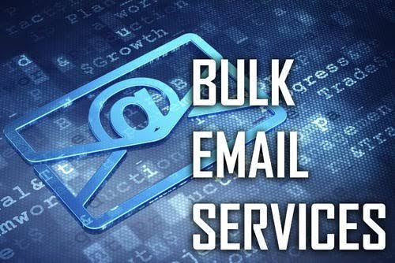
SUMMARY
A bulk SMS or email service which can convey information to larger audience in short interval of time is a requirement. It can include alerts, warnings and news that are of high importance cam needs to be delivered to all the citizens of the country in a single go.

Slide 4

Objective
We need a web page that will allow sending Bulk email user in one go through SMTP or other technology and it will be compatible for that all the users should get an notification also in their mobile through Artificial Intelligence. In addition features like log generation, notification of failure of SMS and/or email delivery, scheduling of SMS/emails, scheduler alert/notification system, users creation with different role and responsibilities, read & unread status, provision of importing contact details from excel worksheets, customizing emails with name of the receiver etc. should be included

Slide 5
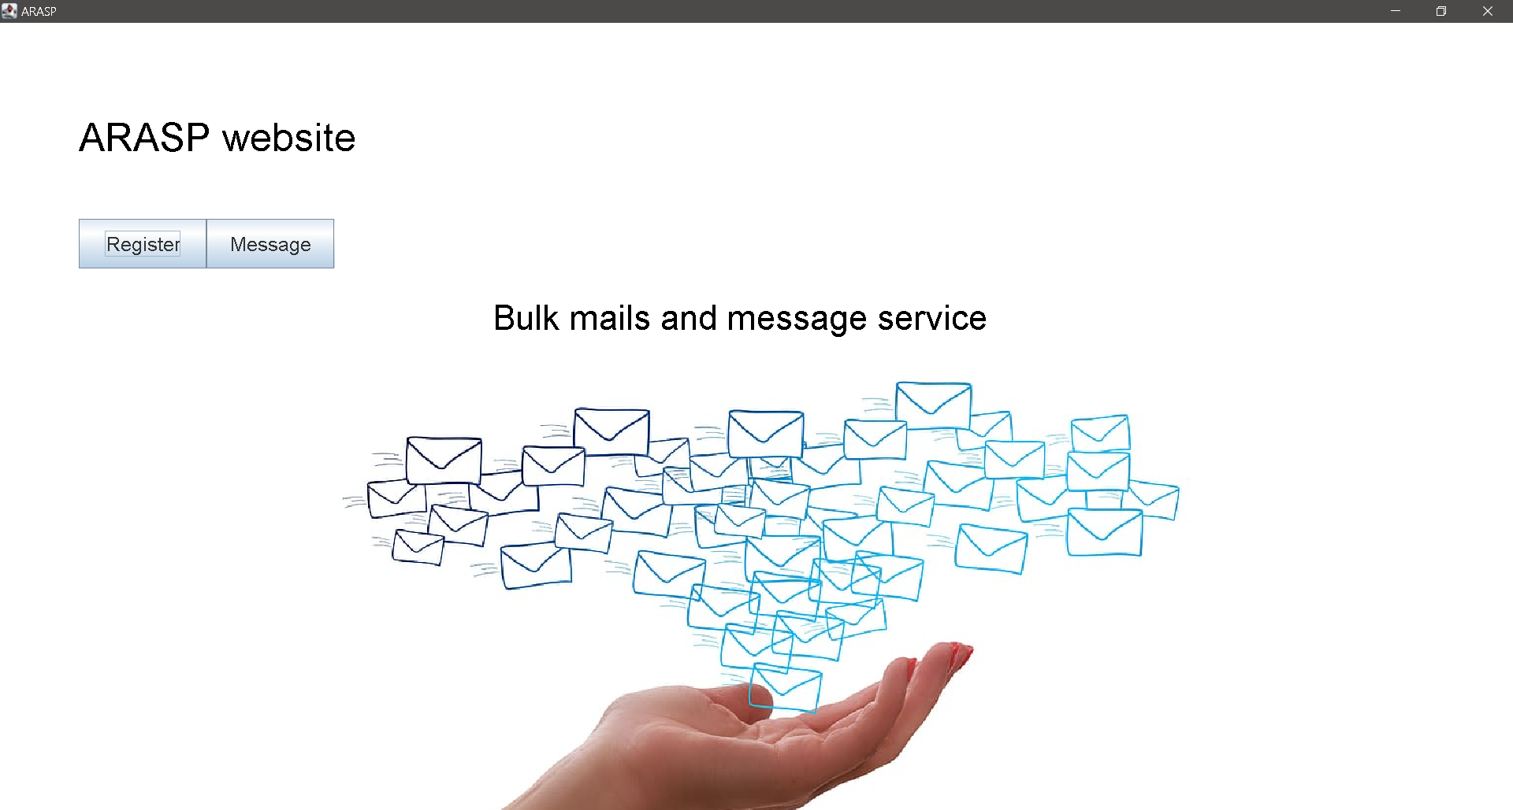
IDEA/SOLUTION
We are creating a web application that will send the emails in bulk at a time for the convenience of the students.
Where the important updates and notifications are directly sent to the students through emails. So they don’t miss out on deadlines .

Slide 6


Technology
Java applet is used to create a webpage for sending bulk emails and messages
Eclipse environment is used here for page to page redirecting to connect to a server

Slide 7
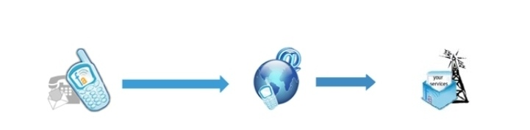
Bulk Emails
Bulk Email is a simple and an instant messaging solution
It allows a fast communication between individuals or groups
Also provides solutions for sending and receiveing single and bulk mails.

Slide 8
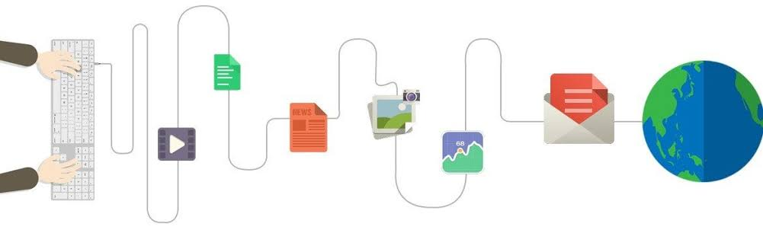
Use cases
Let us take an example of our college bees Erp portal we have all our required information in it but in order to see or check our information we need to login into the website
Some students might forget to fill out feedback forms or the deadline to pay fees might have passed, so this becomes an issue for the students .That's when ARASP comes to the rescue by sending them important alerts and notifications to the students.

Slide 9

Main features
Fast and effective method of communication whole around the world
Single and bulk text messaging
Sheduled mails
Mail history with ful sent report

Slide 10
BULK MAIL SERVICES
USES
Alerts
Marketing
Remainders
Notifications
Personalized priority mails
Bank
Media companies
Large enterprises
USERS
Health care Industry
Marketing
Banking andFinance
Advertising
Social networking
Education Industry
Insurance Industry

Slide 11
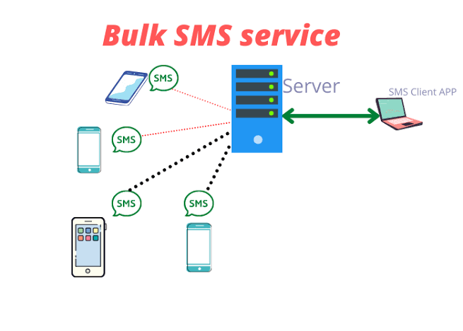
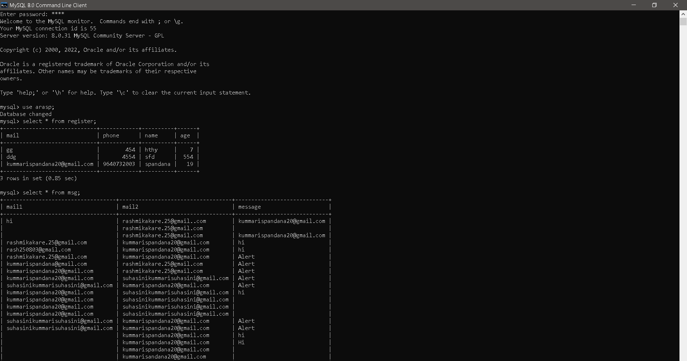

Slide 12
ADVANTAGES
Low cost
Timeless
Flexibility in the issues quantity, time,are and content
Unlimited mails in a single clock
More safe and secured
Short code services

Slide 13
CONCLUSION
At last we want to say that using this website will help us get notified faster and easier and all will get notifications of every important alerts without missing any single mail.
And we can send the information for a group of members at a time using this technique.

Slide 14


